Slide 1

Department of Information Technology
A.P. Shah Institute of Technology G.B.Road,Kasarvadavli, Thane(W), Mumbai-400615
UNIVERSITY OF MUMBAI
Academic Year 2020-2021

Slide 2
A Project Presentation on
Ruchira : An Assistive Platform to Empower Home Sellers
Submitted in fulfillment of the degree of Bachelor of Engineering(Sem-8)
in
INFORMATION TECHNOLOGY
By
Mayuri Deshpande (17104062)
Anuja Apte (17104029)
Sakshi Jain (17104041)
Under the Guidance of Prof. Ganesh Gourshete

Slide 3
1.Project Conception and Initiation

Slide 4
1.1 Abstract
Self employed businesses who manage business of homemade products such as food items, beauty products, selling electronics, catering, clothing and many more will be benefited from the use of this application.
This study aims to determine the factors that motivate entrepreneurs through online business to obtain convenience and comfort.
To obtain convenience , comfort and increase precise in living and living life and
modern life, humans always needs products that are better quality or new products from the business world.

Slide 5
1.2 Objectives
If you plan to establish an online presence for your online business ,you have to consider the objectives and the main purpose for your new website.
To build cross-platform application.
To have multi-lingual support in application.
Promoting various businesses online.
Providing product support or customer service.

Slide 6
1.3 Literature Review
The literature review includes data from various existing apps and compares them to one another.
Sr.No. | Name of the Existing Application | Purpose of the application | Advantages | Disadvantages
1. | Home Minister | Empowering women entrepreneurs by supporting home based,small scale,medium or large scale businesses. | Helps women to earn a living by staying at home. | It has Registration fee to register your business. It is an app only for women.
2. | Big Basket | It’s India’s supermarket app with many trusted users.It is India’s largest grocer that recieves over 100,000 orders per day. | This app helps people buying groceries online and saves the efforts of going outside. | Should add new more categories as Amazon and Flipcart are biggest competetors.
3. | Nykaa | Indian app which allows you to choose over 1 lakh beauty product and 850+ brands. | Various brands and products within pocket friendly range. | Bad Customer care service.

Slide 7
1.4 Problem Definition
Due to some family issues few businessmen/ women cannot go out for work, and their products are not reachable to consumers . To avoid this kind of difficulty we are developing a social platform using E-commerce so that everyone can work by staying at home and make a living out of it.
This pandemic is an amazing example of how and why we need an app for buying homemade products as getting products from shop was nearly impossible.
There is an existing web application we are recreating it by adding additional features
in our project like language option and audio detection.

Slide 8
1.5 Scope
Can be useful in future for registration of the dealers and promote their products online through this platform.
Can be benefited for such pandemic situations.
Can further be useful to add more functionality such as alexa and siri to make it more user-friendly.

Slide 9
1.6 Technology stack
Andriod studio
Java
XML

Slide 10
1.7 Benefits for environment & Society
Selling homemade prouducts is benificial for enovironment and society in many ways, one of which is that it is good for environment as it does not contribute to any kind of pollution i.e noise, air pollution etc.
Another benefit is that selling homemade products means supporting local economy.
Items that are handmade take less energy and natural resources to produce than items made on a mass production assembly line

Slide 11
2. Project Design

Slide 12
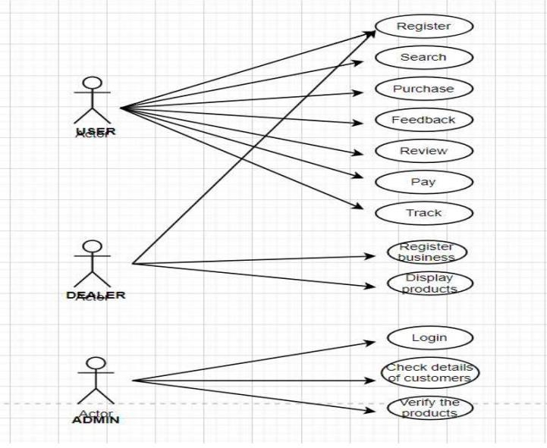
2.1 Proposed System

Slide 13
2.2 Design(Flow Of Modules)
The flow of modules is in such a way that includes login and authentication, catalouging and order fulfillment.
Login and authentication
Cataloguing
Order
fulfilment

Slide 14
2.3 Description Of Use Case
This is diagramatic representation of use case. It states various steps that customer can follow to go through various products.
Search catalogue
Login register
Manage Account
Manage profile
Add to cart
Customer
Manage cart
View cart
Place order

Slide 15
2.4 Activity diagram
Login
Authentication
IF not logged in
Create account
Valid
Search product
Add to cart
View cart
Confirm order
Cancel order
Logout

Slide 16
2.5 Module-1
LOGIN and AUTHENTICATION
Login and authentication is the first step to start any application.
This module is essential for security purpose as it is process of verifying someone’s
identity by using pre-required details.
When a user registers for an account, they create their unique ID and key which will allow them to access their account later on.

Slide 17
Module-2
CATALOGING
Catalogue is a dynamic process where products are organized in a specific way to ensure consistent and high-quality data across various sales.
Online catalogue involves product names, descriptions, price, supplier and other
related details.
In this app, during cataloguing we also come across search tab and viewing various activities.

Slide 18
Module-3
ORDER FULFILLMENT
In order fulfilment, you can add the viewed items into cart by selecting add to cart option.
After adding the item desired, we can further confirm order and make payment or
cancel the order if you do not wish to purchase the item.

Slide 19
3. Conclusion and Future Scope

Slide 20
The Internet has opened so many opportunities for doing business online, and E- commerce is one of the most popular ones. Not only does it require low investment, it actually is a type of business that does not require a full time commitment , especially if you are selling limited no of products.
You just make an online presence and promote the business using both free and paid
methods. However as each business has its positive and negative sides.
If you want to achieve success ,you will have to create an organized strategy which is
based on realistic goals and comprehensive analysis of the market.

Slide 21
References
www.homeminister.com
www.nykaa.com app-nykaa
www.bigbasket.com

Slide 22
Thank You

